Slide 1

Creating Effective Graphs with R
Multi-panel Graphs
17 June 2019
Copyright © 2019 Naomi B. Robbins

Slide 2
Multi-panel graphs
Scatterplot matrices
Trellis / faceting / small multiples / lattice /panel graphs
One common scale
Linked micromaps

Slide 3
Stacked Bar Chart: Petroleum Stocks
Millions of gallons

Slide 4
Scatterplot Matrix of Energy Data

Slide 5
Reading Scatterplot Matrix

Slide 6
Multi-panel graphs
Scatterplot matrices
Trellis / faceting / small multiples / lattice /panel graphs
One common scale
Linked micromaps

Slide 7
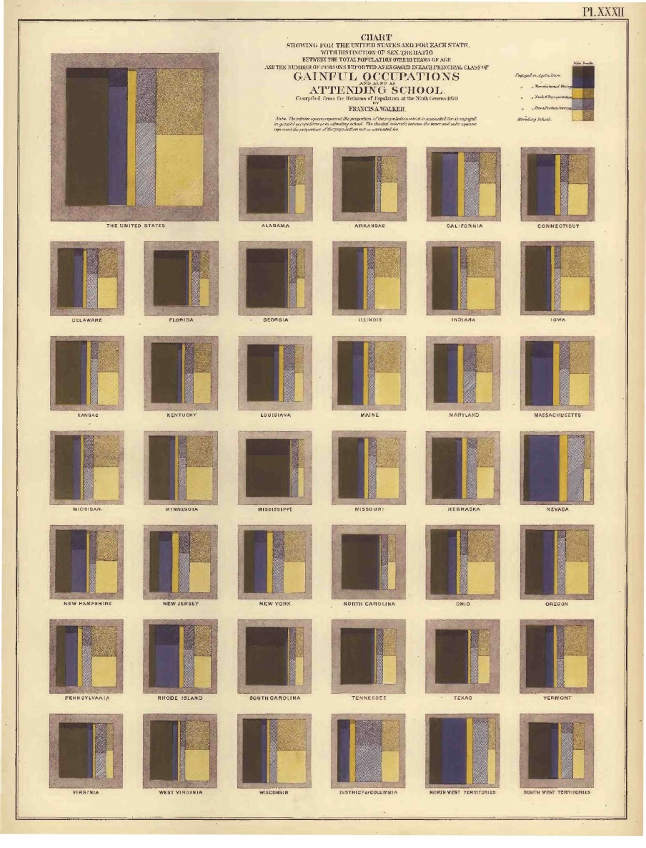
1870 Census Data
Statistical Atlas of the United States
Persons with gainful occupations and attending school, Walker (1874)

Slide 8
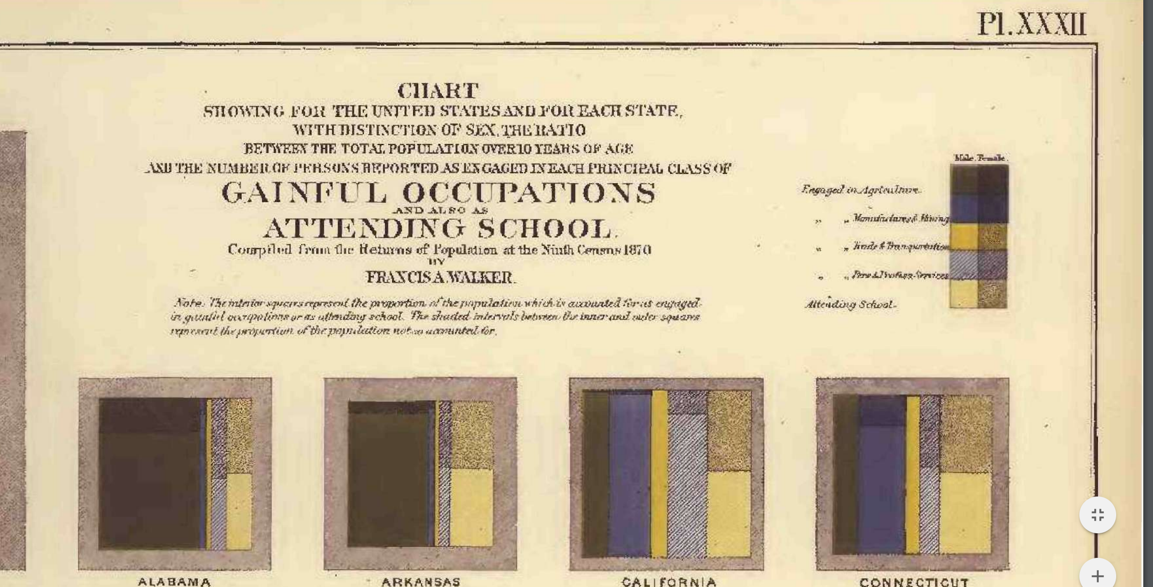
Top Enlarged

Slide 9
Terminology
Multi-panel Plot: any plot with more than one panel.
Small Multiples (Tufte): “a series of graphics, showing the same combination of variables, indexed by changes in another variable.” Tufte VDQI page 70
Trellis Display or Faceted Graphs: Small multiples which often have structure imposed; e.g., ordering of panels.
Term trellis also used for a graphics system in S-Plus
Trellis thought to be trademarked by Tibco
Called lattice or faceted by R community
Called panel charts by Excel users

Slide 10
Before: 3-D Bar Chart

Slide 11
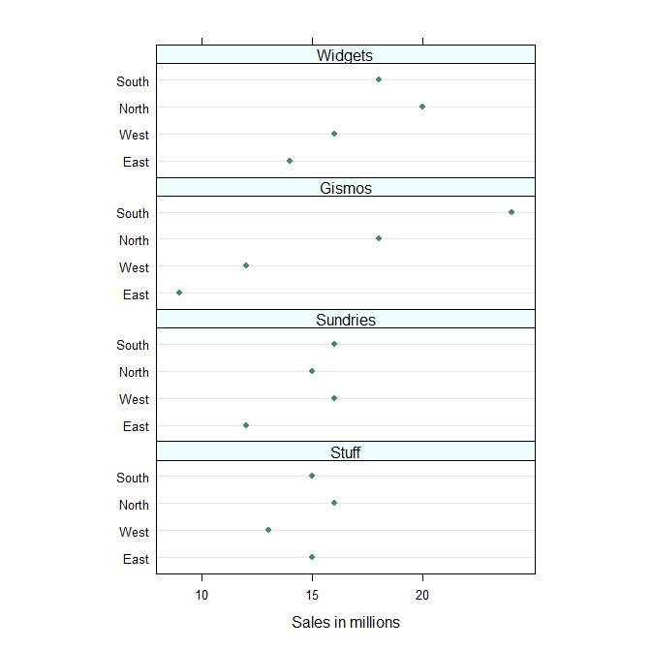
Trellis Display of Same Data

Slide 12
Comparison

Slide 13
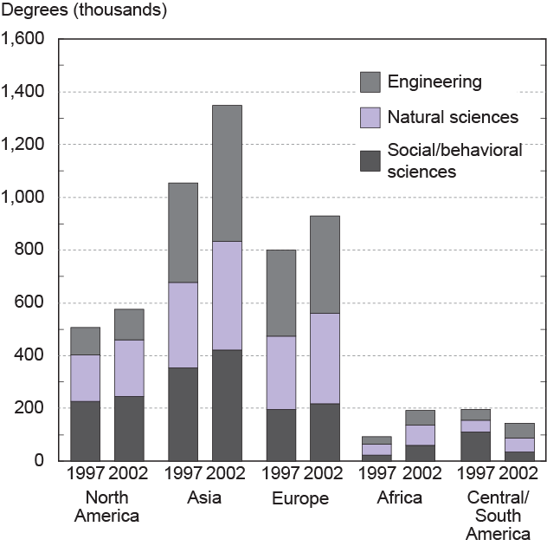
Before: Grouped and Stacked Bar Charts
Source: National Science Foundation Science aand Engineering Indicators 2006

Slide 14
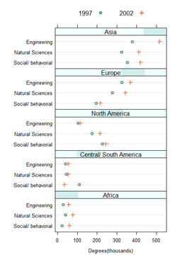
Left and right plots emphasize different aspects of the data.

Slide 15
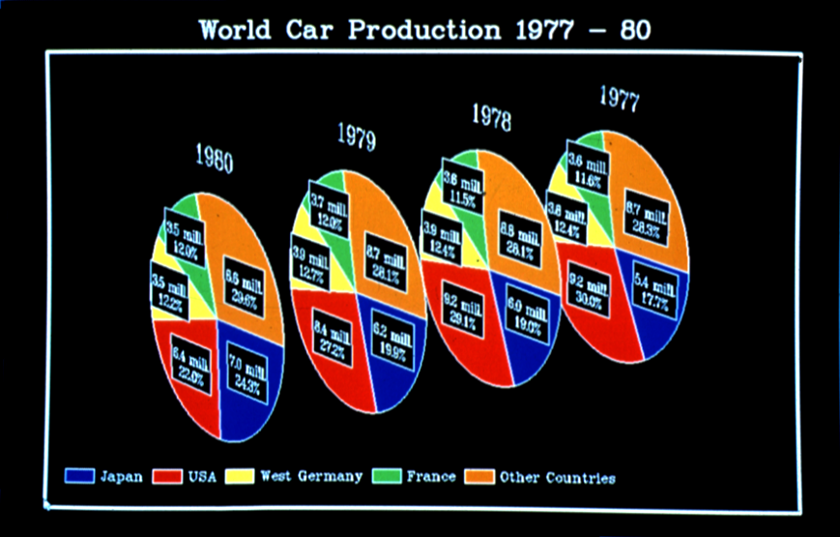
Before: Multiple Pie Charts

Slide 16
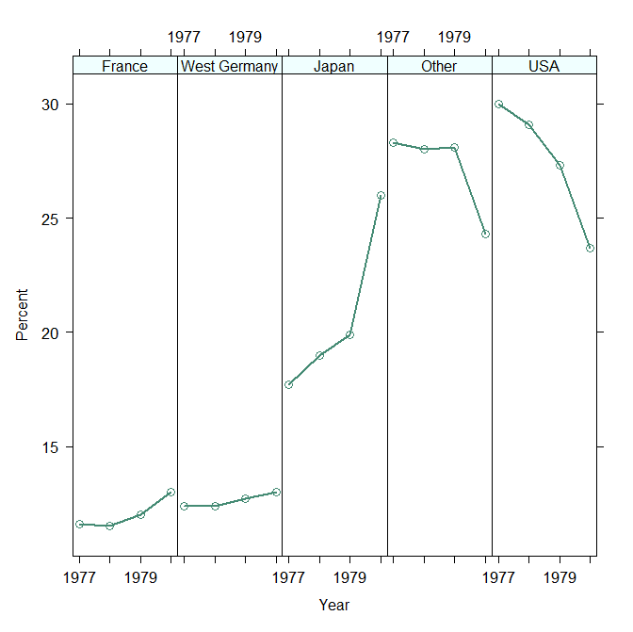
Trellis Display

Slide 17
Trellis Display: Barley Example

Slide 18
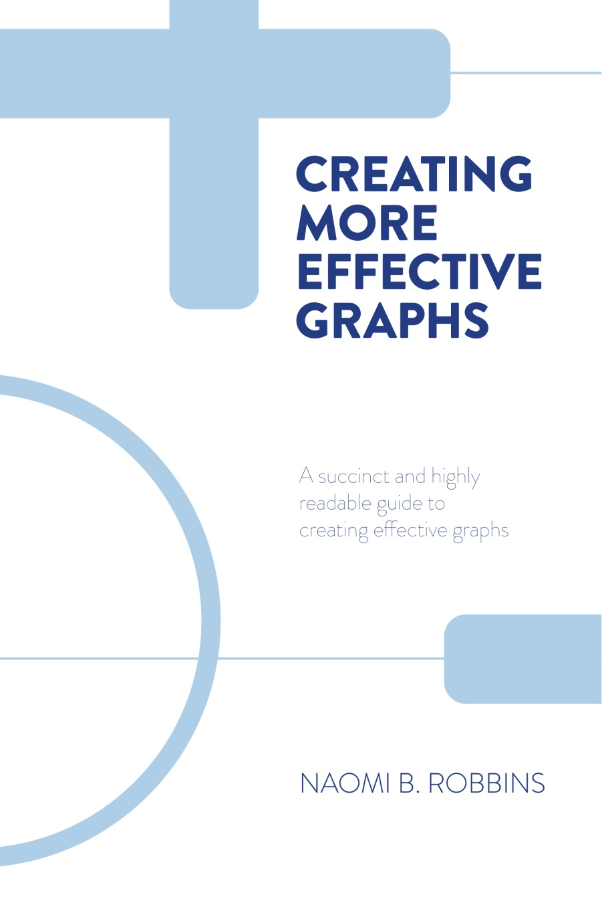
New Cover Design

Slide 19
Trellis - Barley Example

Slide 20
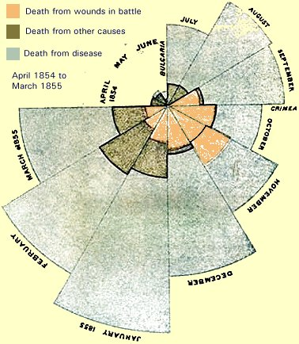
Nightingale’s Rose

Slide 21
Trellis Display of Nightingale Data

Slide 22
No Ambiguity with Trellis Plot

Slide 23
Quotes
“The number of times that dot charts and multipanel trellis displays were used in the after figures demonstrates their usefulness.” Robbins. Creating More Effective Graphs. page 327.
“At the heart of quantitative reasoning is a single question: Compared to what? Small multiple designs, multivariate and data bountiful, answer directly by visually enforcing comparisons of changes, of the differences among objects, of the scope of alternatives. For a wide range of problems in data presentation, small multiples are the best design solution.” Tufte. Envisioning Information. page 67

Slide 24
Multi-panel graphs
Scatterplot matrices
Scatterplot matrices
Trellis / faceting / small multiples / lattice /panel graphs
One common scale
Linked micromaps

Slide 25
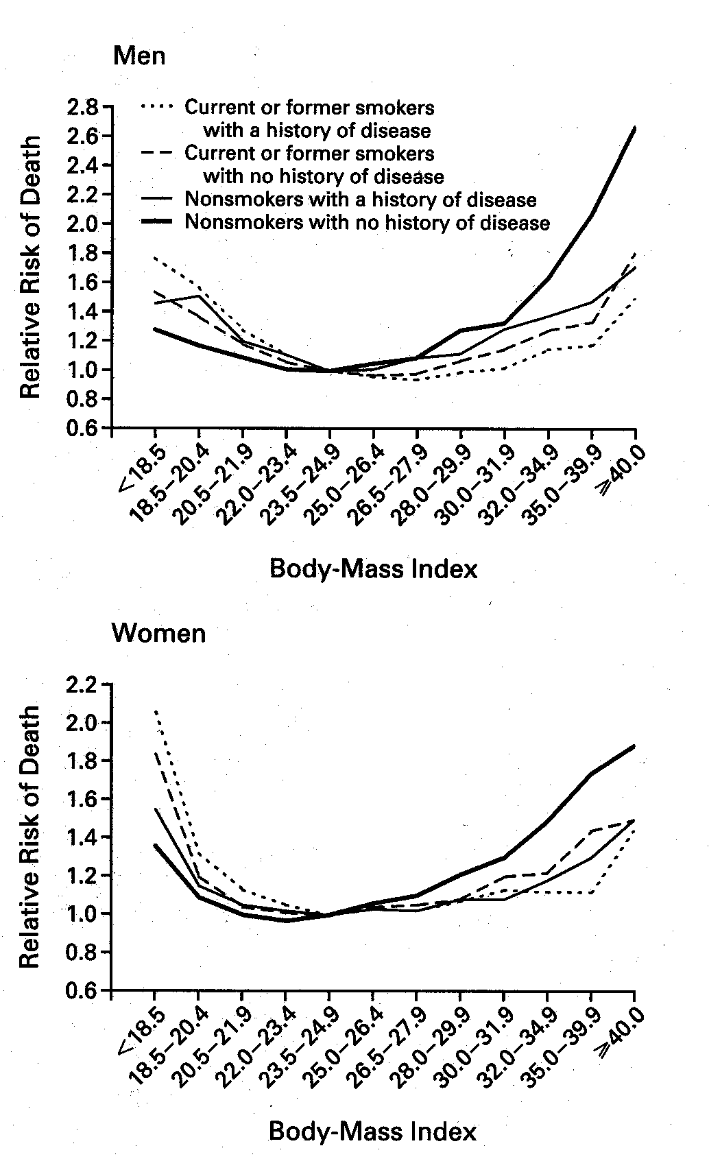
Comparisons with different scales

Slide 26
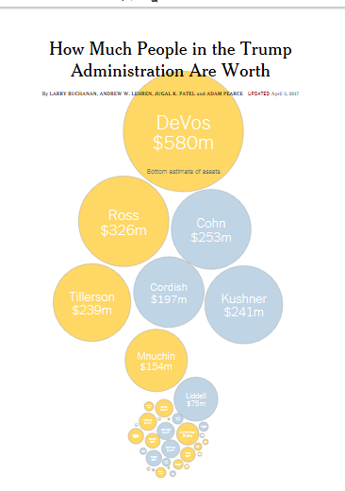
Source:
NYT 3 Apr. 2017
Updated

Slide 27
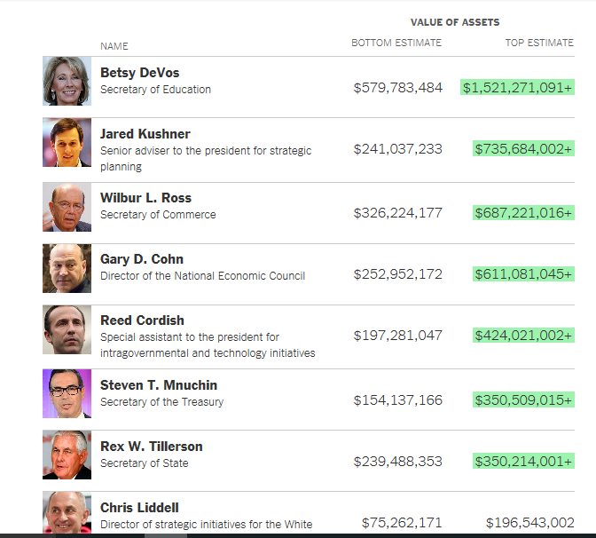

Slide 28
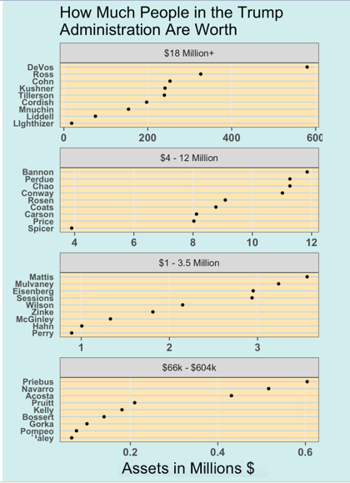
Source:
Joyce Robbins

Slide 29
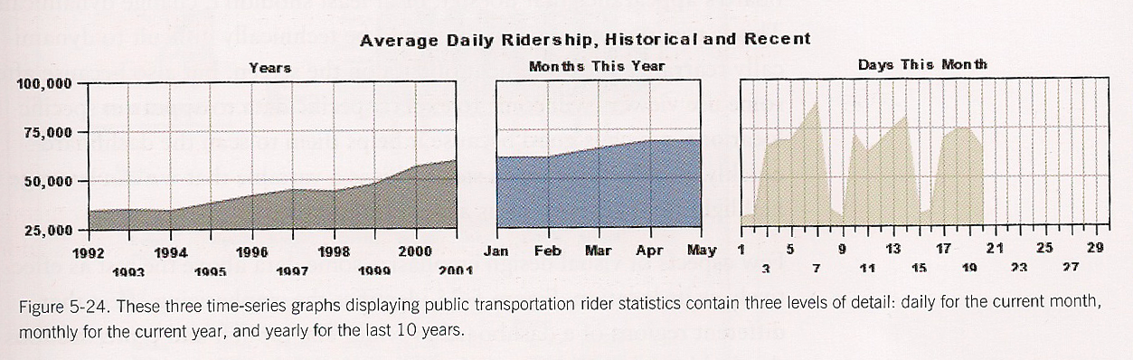
Multi-foci figure

Slide 30
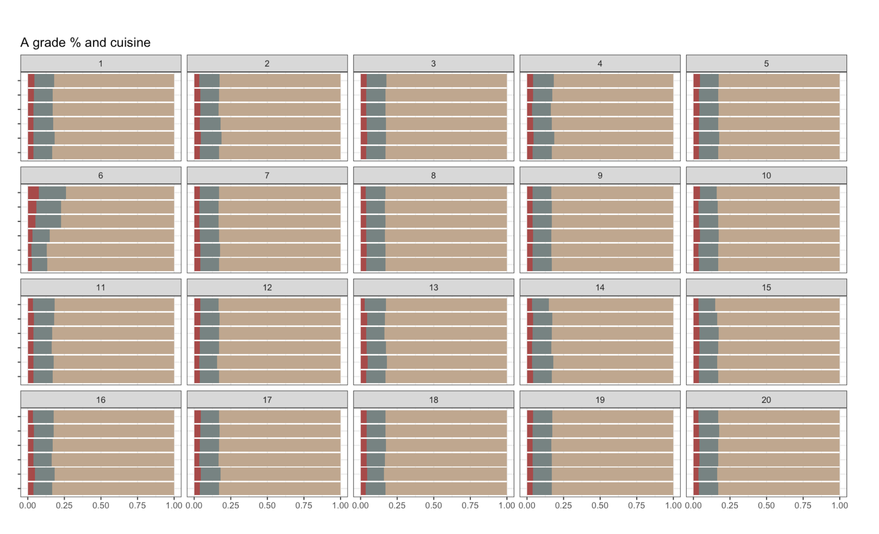
Slide from Di Cook’s Nullibar Talk
120

Slide 31
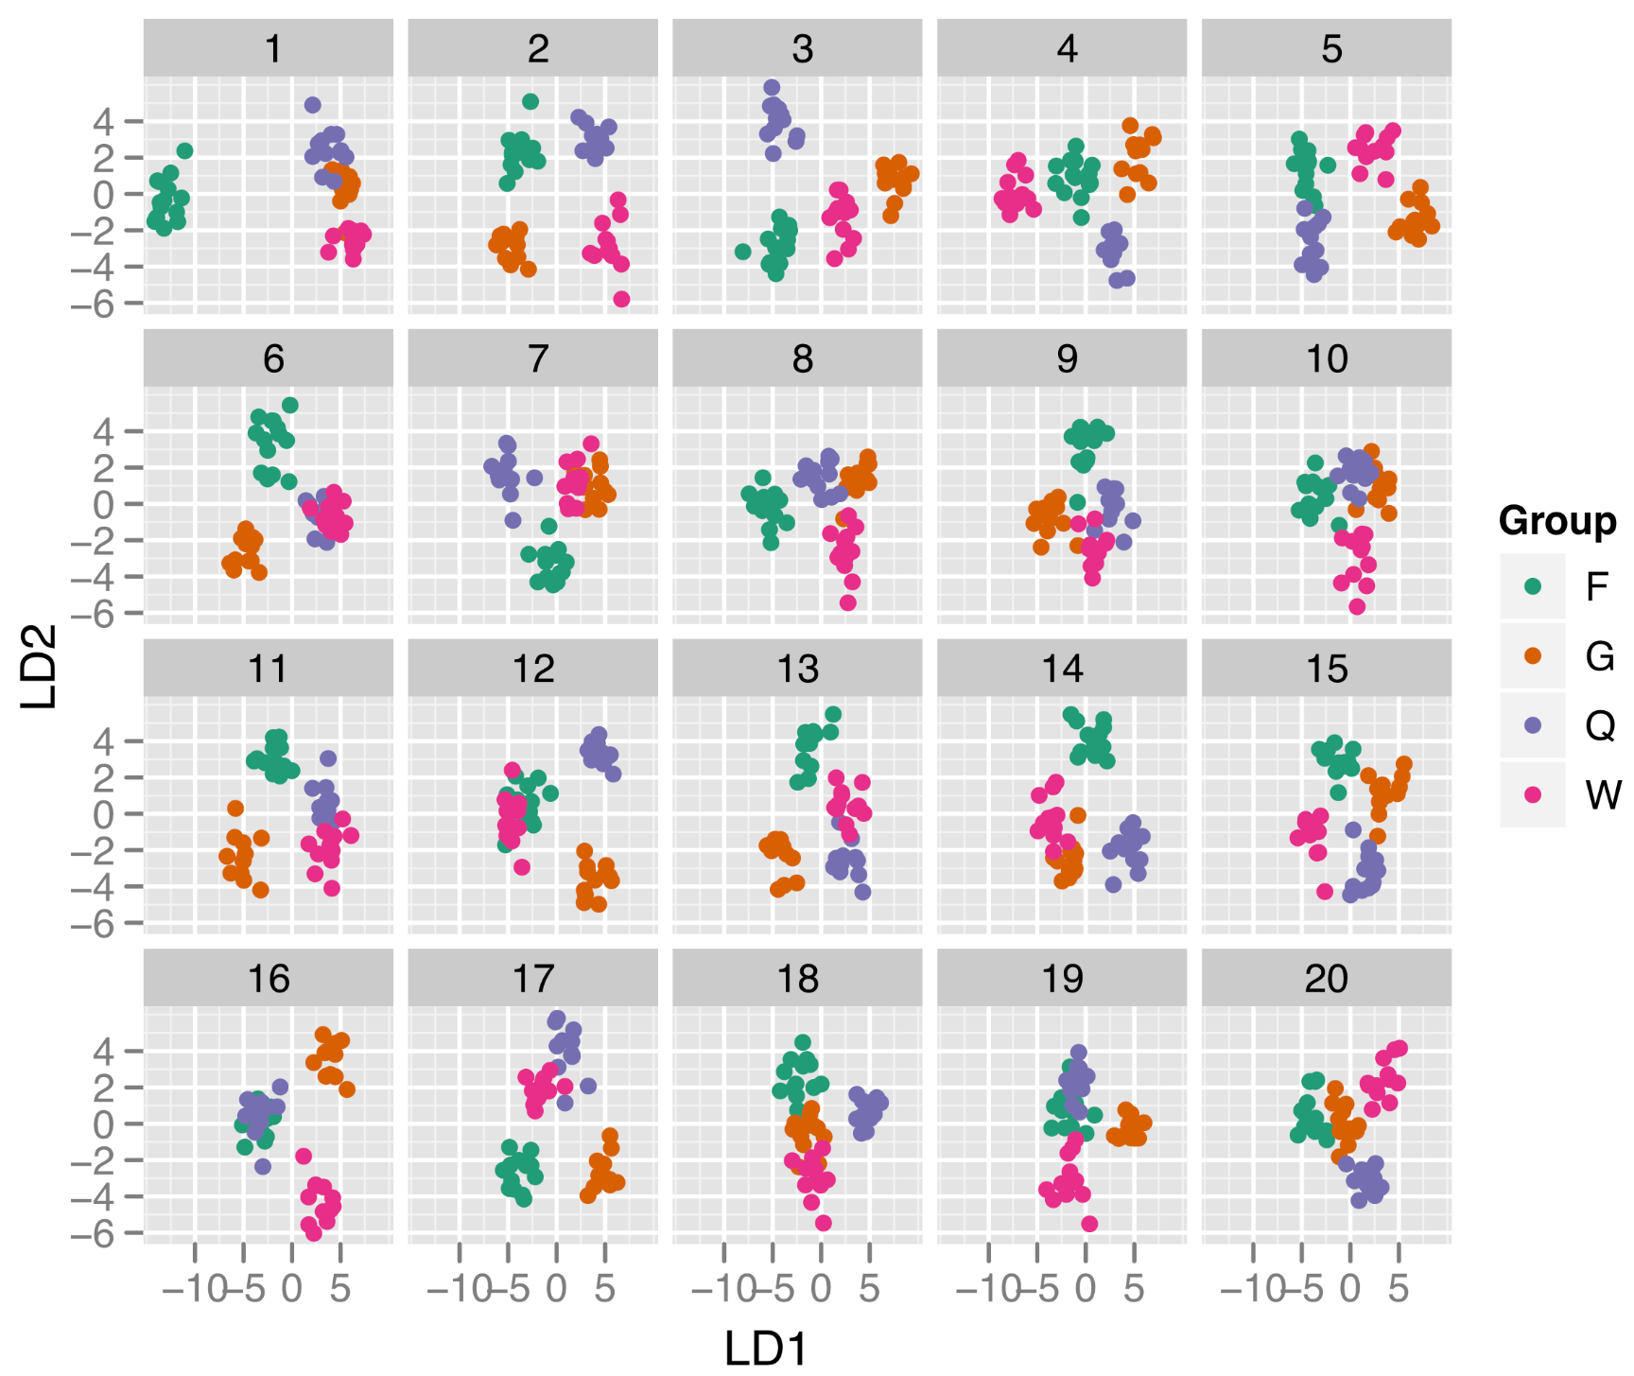
Another

Slide 32
Multi-panel graphs
Scatterplot matrices
Trellis / faceting / small multiples / lattice /panel graphs
One common scale
Linked micromaps

Slide 33
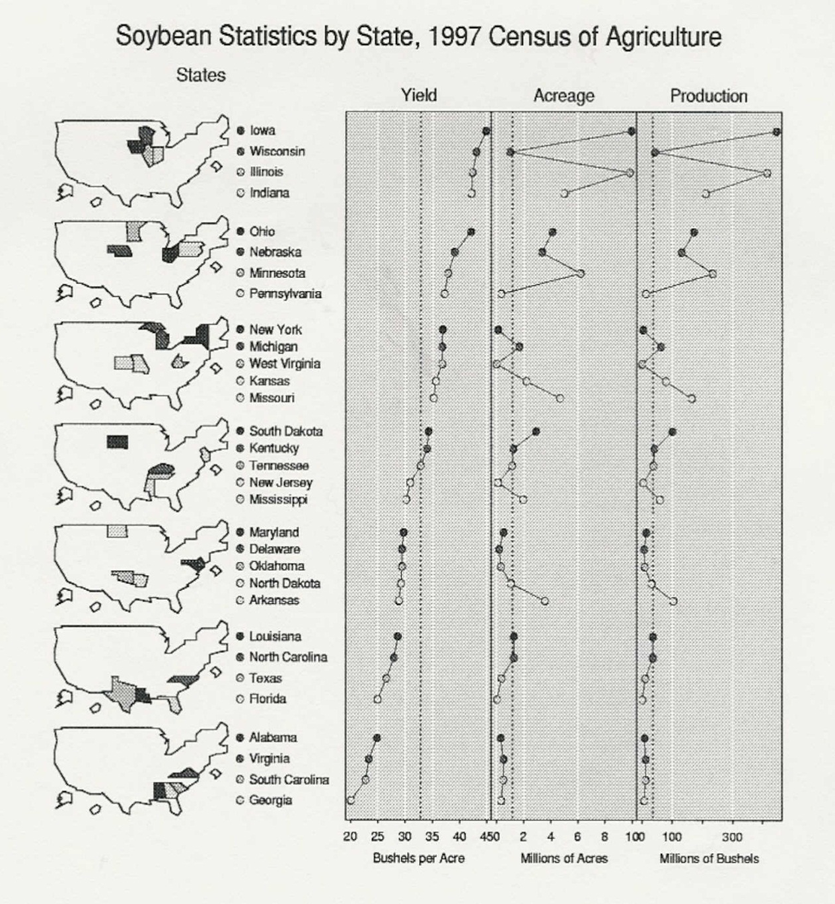
Linked Micromap

Slide 34
Must Read
Carr, Daniel and Linda Pickle. 2010. Visualizing Data Patterns with Micromaps. Chapman and Hall/CRC, Boca Raton, FL.

Slide 35
Conclusions
Multi-panel charts are often clearer than more commonly used charts
They are underused.
They often avoid the need for color.
They aid comparisons.
They avoid the need for legends.

Slide 36
References
Cleveland, William S. 1993. Visualizing Data. Hobart Press, Summit, NJ.
Cleveland, William S. 1994. The Elements of Graphing Data. Hobart Press, Summit, NJ
Few, Stephen. 2006. Information Dashboard Design: the Effective Visual Communication of Data. O’Reilly.
Robbins, Naomi B. 2013. Creating More Effective Graphs, Chart House, Ramsey, NJ
(Reprinted from Wiley (2005))
Robbins, Naomi B. 2006. “Dot Plots: A Useful Alternative to Bar Charts,”
http://www.b-eye-network.com/view/2468

Slide 37
References - continued
Tufte, Edward. 2001. The Visual Display of Quantitative Information. Graphics Press, Cheshire, CT.
Tufte, Edward. 1990. Envisioning Information, Graphics Press, Cheshire, CT.
US Bureau of the Census. 1874. Statistical Atlas of the United States. https://fraser.stlouisfed.org/title/64 Accessed June 7, 2019.

Slide 38
Useful Web Site
Jon Peltier has utilities to draw many of these charts in Excel.
https://www.peltiertech.com

Slide 39
Contact Information
Naomi B. Robbins
NBR
11 Christine Court
Wayne, NJ 07470
Phone: (973) 694-6009
naomi@nbr-graphs.com
http://www.nbr-graphs.com
http://www.forbes.com/sites/naomirobbins/
twitter: @nbrgraphs
Author of Creating More Effective Graphs

